Slide 1
Mesoamerican Civilization
SCIENCE AND HUMANISM
MAYA, INCA, AND AZTEC

Slide 2
Mesoamerican civilization, the complex of indigenous cultures that developed in parts of Mexico, Central and South America prior to Spanish exploration and conquest in the 16th century.
Of the many early civilizations first living in this area, the Mayans, Aztecs, and Incas are the best known and offer a broad understanding of early life in these areas.

Slide 3
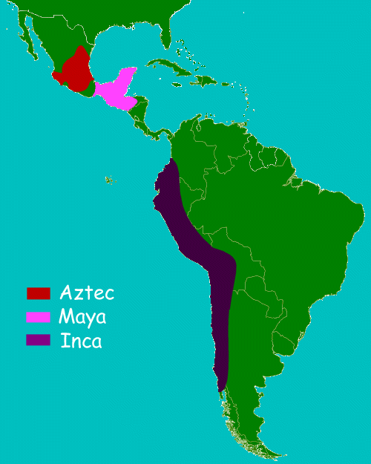
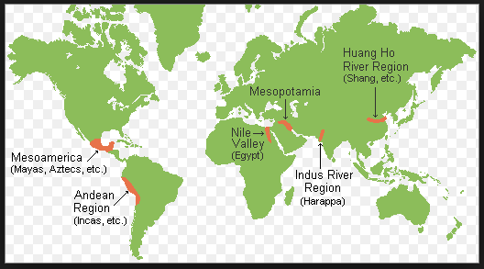
GEOGRAPHY

Slide 4
Maya :
Mayan civilization occupied much of the northwestern part of the isthmus of Central America, a territory which is now part of southern Mexico, Guatemala, and northern Belize.
As early as 1500 BCE the Maya had settled in villages and were practicing agriculture.
Maya reached a peak between A.D. 250 and 900, a time that archaeologists call the "Classic" period when numerous Maya cities flourished throughout much of Central America.
At its height, Mayan civilization consisted of more than 40 cities, each with a population between 5,000 and 50,000.
After 900 CE, however, the Classic Maya civilization declined precipitously, leaving the great cities and ceremonial centers vacant and overgrown with jungle vegetation

Slide 5
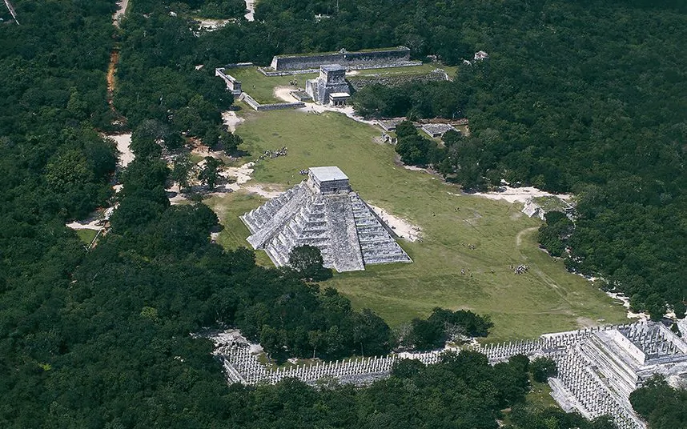
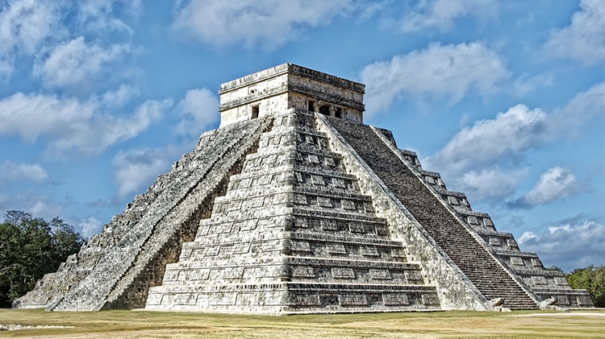
Archeological site of Ancient Maya city ‘Chichen Itza’
El Castillo (Kukulkan pyramid) at Chichen Itza
The ancient Maya managed to build elaborate temples and great cities without what we would consider to be essential tools: metal and the wheel. Chichen Itza, a dazzling ancient city that once was the centre of Maya empire. The stepped pyramids, temples, columned arcades, and other stone structures of Chichen Itza were sacred to the Maya. This city was also a sophisticated urban center of their empire.

Slide 6
Maya Science and Technology :
To see the achievements of Maya Peoples, Please go through the link mentioned below :
https://www.ancienthistorylists.com/maya-history/top-10-inventions-of-mayan-civilization/

Slide 7
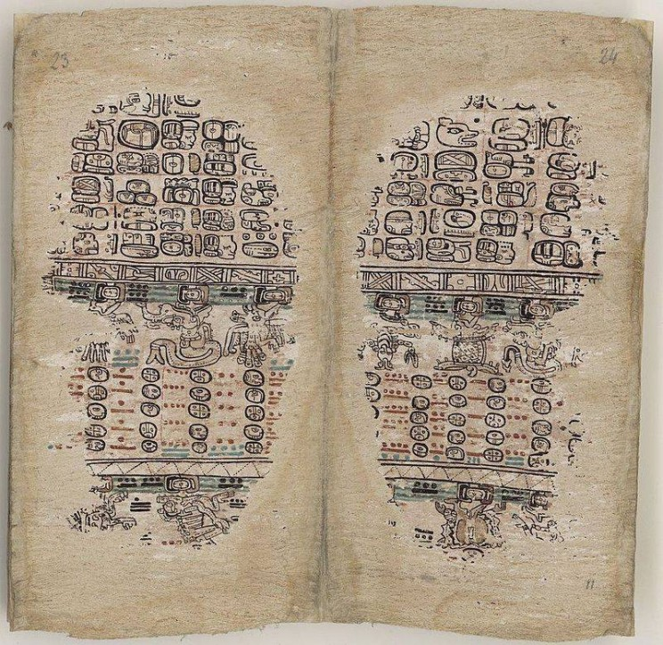
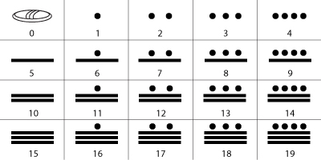
1. The last two pages of the 'Paris Codex' one of the few surviving Mayan books. (L)
2. Mayan numeral system (R)
https://www.maa.org/book/export/html/117895

Slide 8
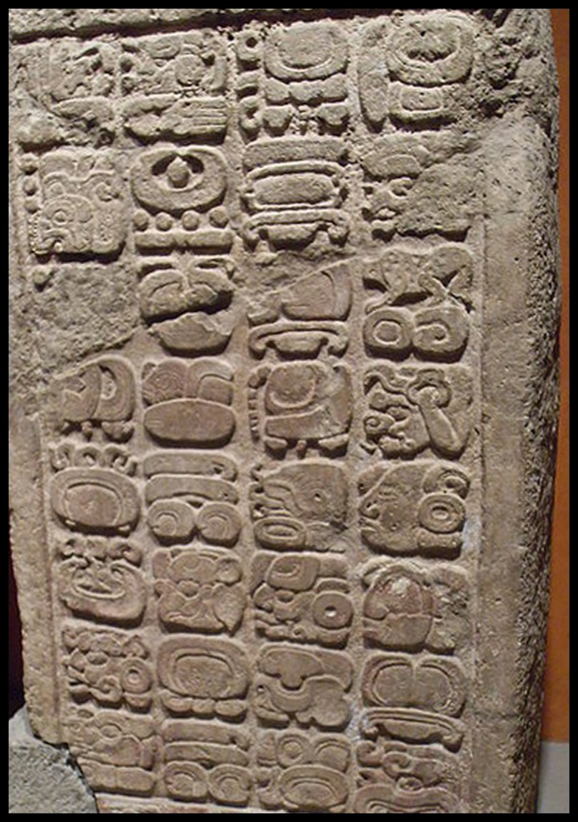
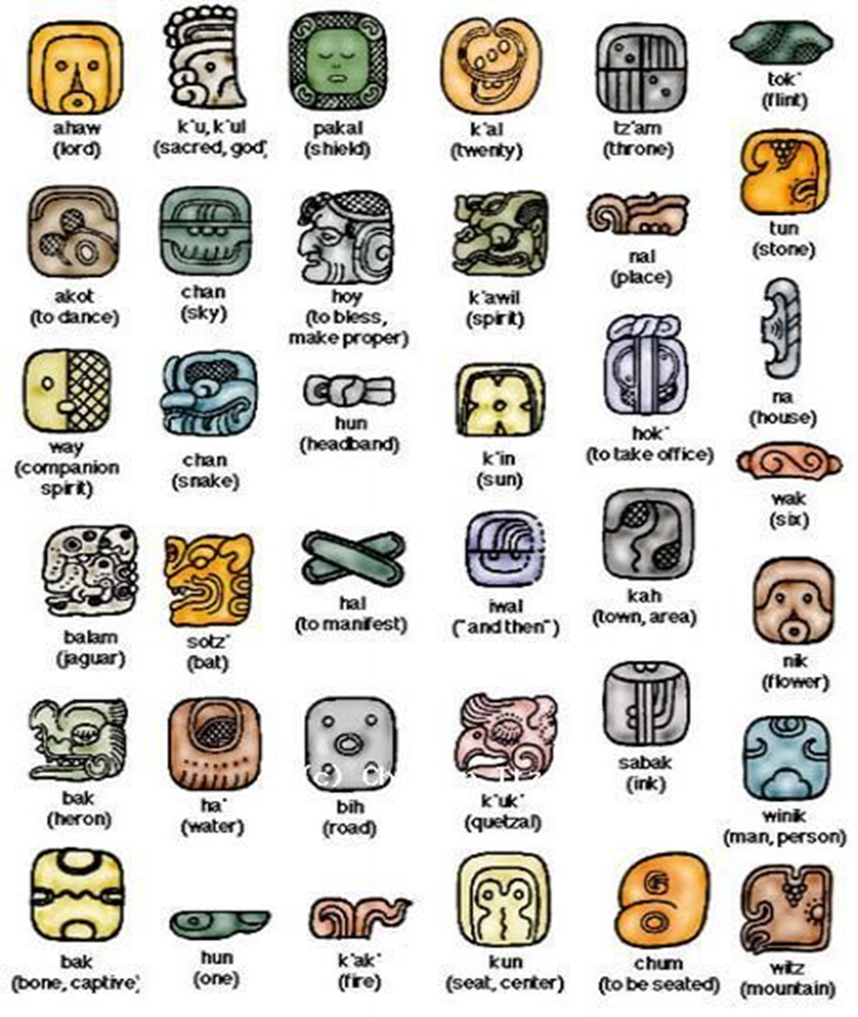
Mayan hieroglyphs

Slide 9
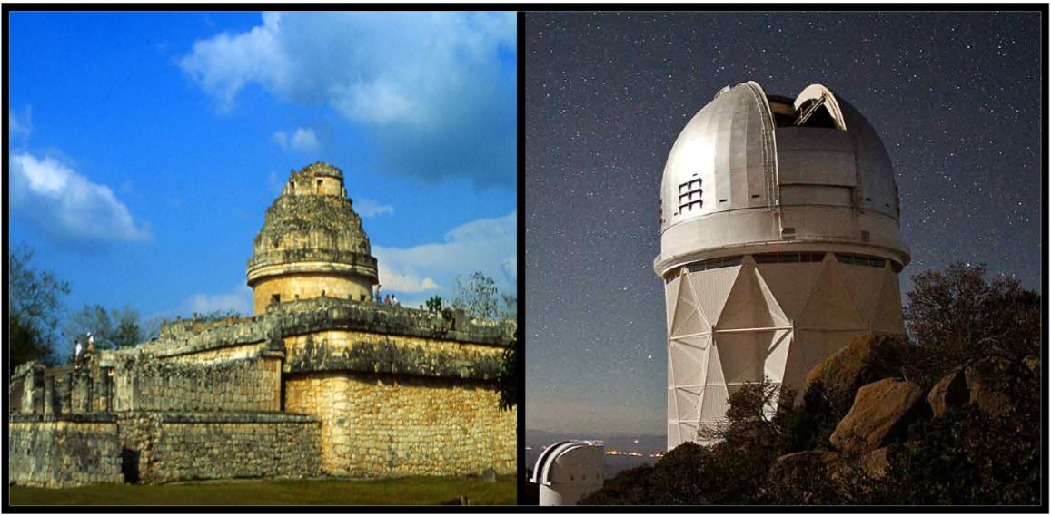
The ancient Maya observatory, El Caracol, (L) looks remarkably similar to the modern Kitt Peak National Observatory. (R)

Slide 10
Inca :
The Inca Empire was a vast empire that flourished in the Andean region of South America from the early 15th century A.D. up until its conquest by the Spanish in the 1532. Even after the conquest, Inca leaders continued to resist the Spaniards up until 1572, when its last city, Vilcabamba, was captured.
In less than a century, during the 1400s, Inca People built one of the largest, most tightly controlled empires the world has ever known.
Their skill in government was matched by their feats of engineering. Roads, walls, and irrigation works. These constructions by the Incas are still in use today.
Inca left no written records. Their history is known chiefly from the oral tradition that has been preserved through the generations by official “memorizers” and from the written records composed from them after the Spanish conquest.

Slide 11
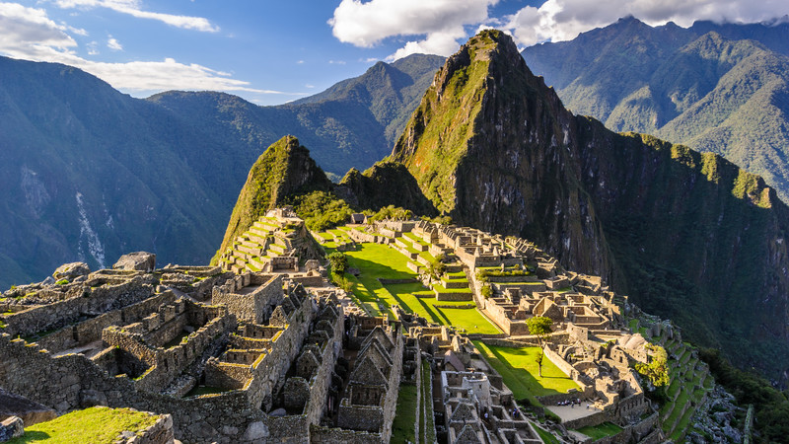
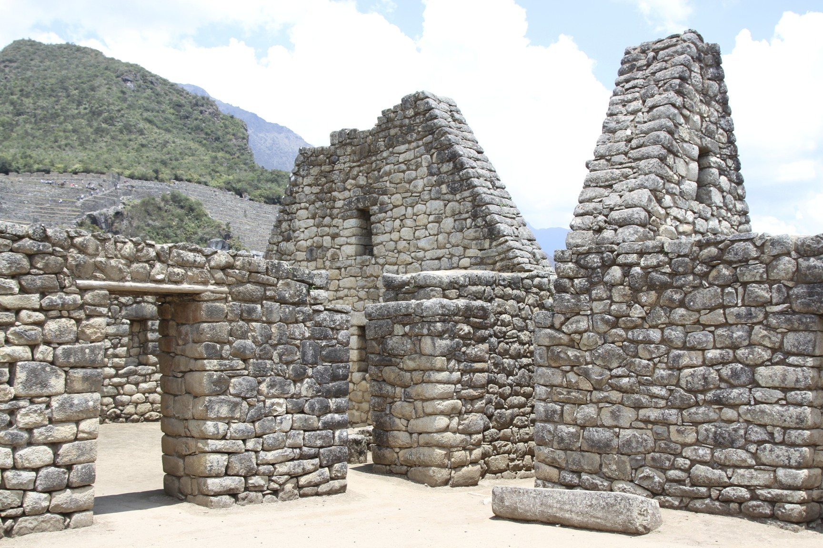
Archeological site of Inca City ‘Machu Picchu’
Stone Buildings at Machu Picchu
The construction of Machu Picchu began around the time the Inca began to expand their territory across the continent. Its strategic location was chosen with admirable success. Surrounded by steep cliffs and away from the sight of strangers in a tangled forest, the citadel of Machu Picchu had the quality of having only one narrow entrance so that only a few warriors were needed for defense in the event of a surprise attack.

Slide 12
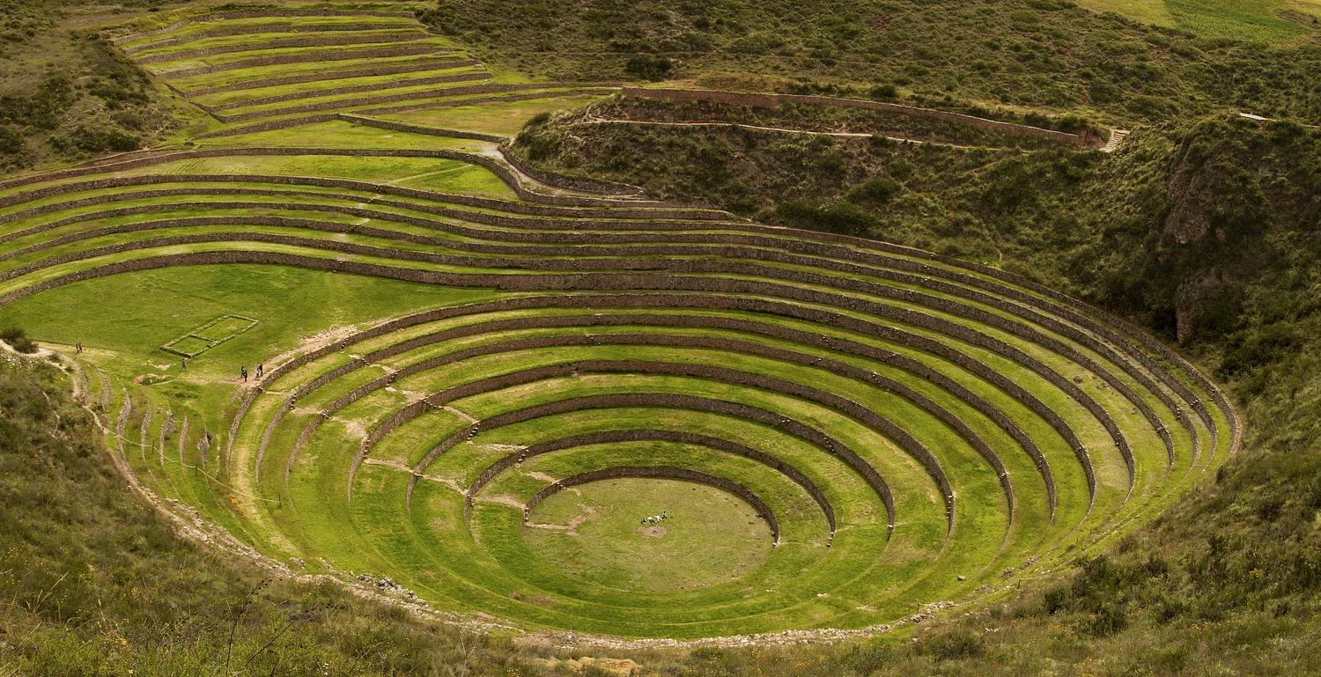
Inca Terrace Farming
Terrace Farming was one of the popular agricultural practices adopted by several Mesoamerican societies. In places where flatlands were rare, the creation of terraces on steep hillsides helped in reducing water runoff and avoiding erosion.
https://interestingengineering.com/culture/mysterious-agricultural-terraces-incas

Slide 13
Inca Science And Technology :
To understand the scientific and technological skills of Inca Peoples, Please go through the link mentioned below :
http://www.historyshistories.com/inca-science-innovation--technology.html

Slide 14
Aztec :
The Aztec Empire flourished between c. 1345 and 1521 CE and, at its greatest extent, covered most of northern Mesoamerica.
Highly accomplished in agriculture and trade, the last of the great Mesoamerican civilizations was also noted for its art and architecture which ranks amongst the finest ever produced on the continent.
The Spanish conquistadors laid siege to the Aztec capital Tenochtitlan from the middle of May of 1521 until they surrendered on August 13, 1521.
The Aztec state is actually the most well-documented Mesoamerican civilization with sources including archaeology, native books (codices) and lengthy and detailed accounts from their Spanish conquerors - both by military men and Christian clergy.

Slide 15
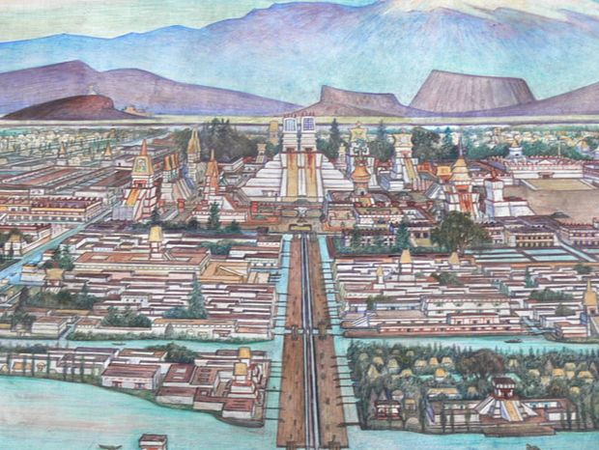
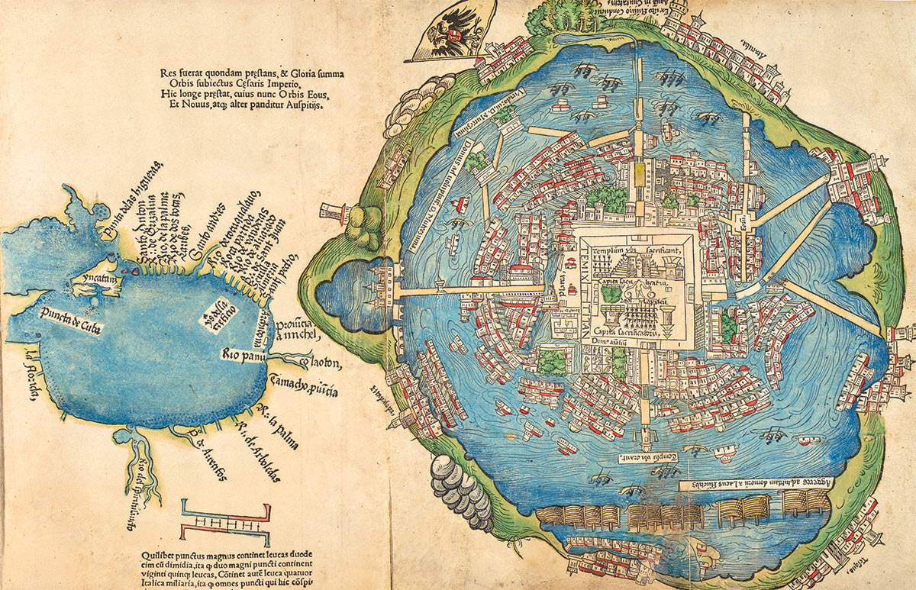
Aztec city Tenochtitlan
First European Map of Tenochtitlan (1524)
Tenochtitlan was the main city of the Aztec Empire and was located in the Valley of Mexico. The unique lake location of Tenochtitlan meant that the city had many different waterways that connected its different sections. Very little of the city has survived into modern day as it was mostly destroyed by Spanish conquistadors during the Spanish conquest of the Aztec Empire.

Slide 16
Aztec Science and Technology :
To know about the advancements of Aztecs, Please go through the link mentioned below :
https://www.aztec-indians.com/aztec-technology.html

Slide 17
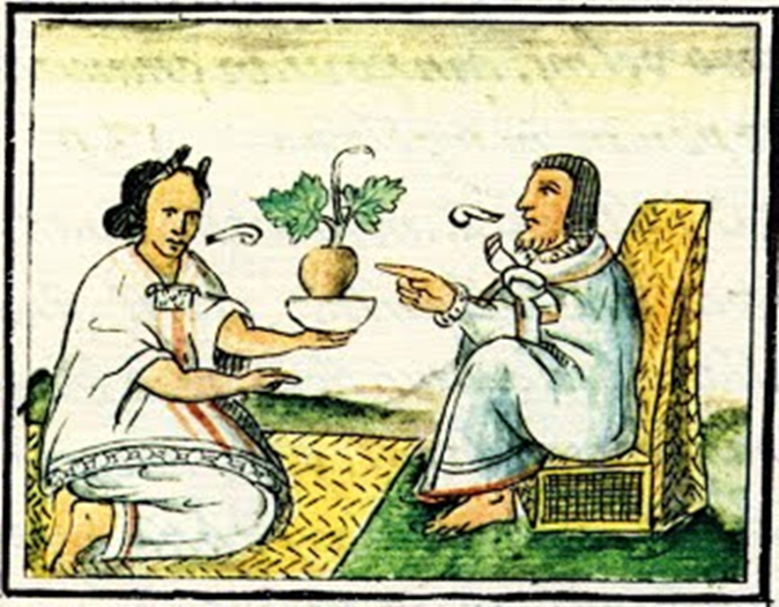
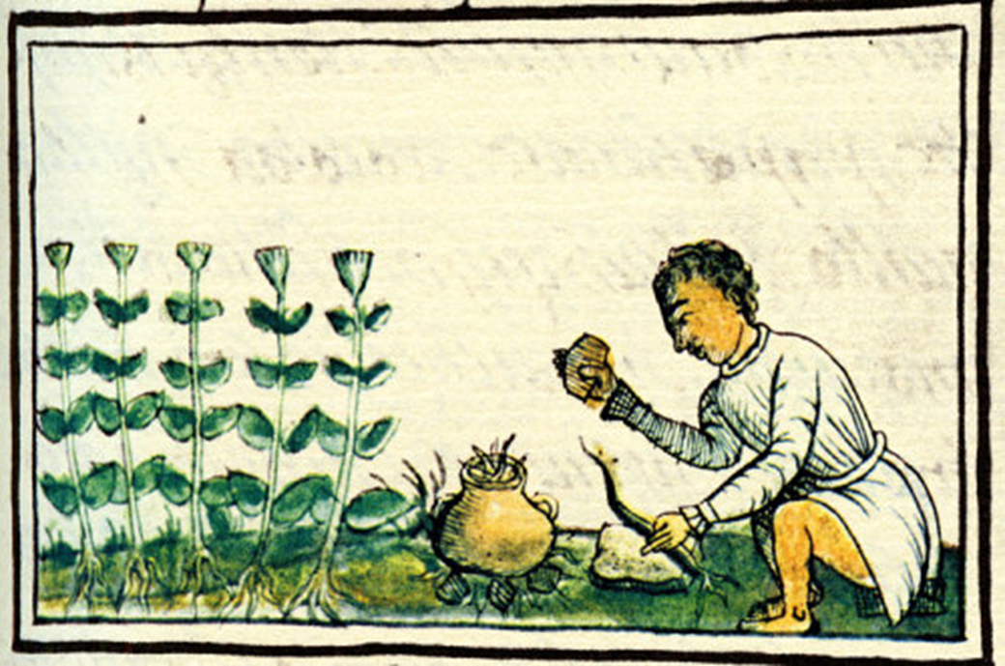
Pictures are the part of The Florentine Codex, a 16th century manuscript documented by Spanish ethnographer Bernardino de Sahagún. It documents the culture, religious cosmology (worldview), ritual practices, society, economics, and history of the Aztec people. These pictures shows the medicinal advancement of Aztecs and their knowledge about the herbal plants.

Slide 18
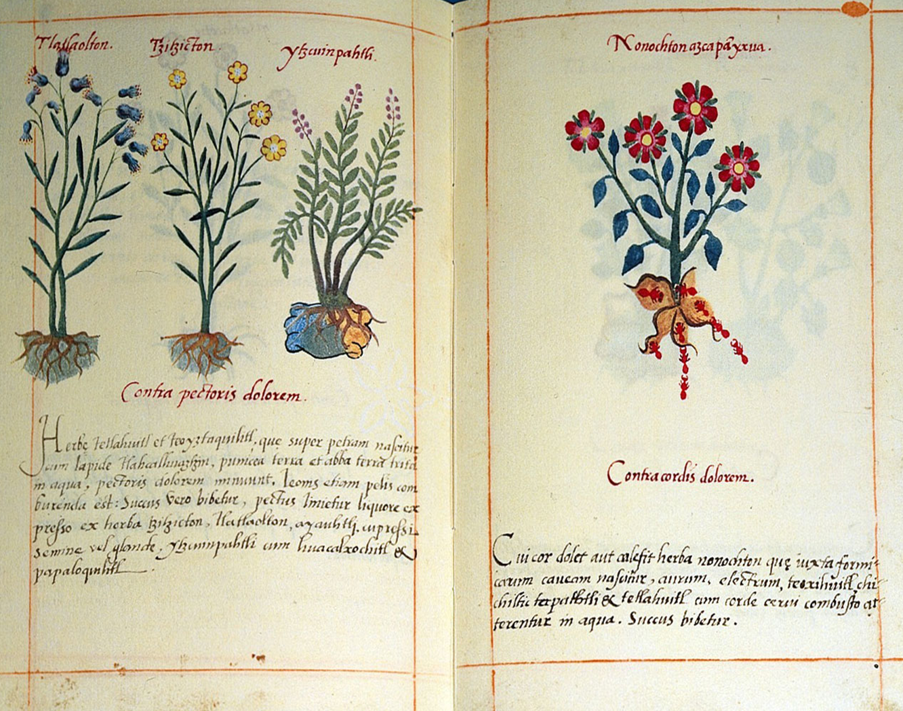
The Libellus de Medicinalibus Indorum Herbis, also known as ‘Codex Badianus’ is an Aztec herbal manuscript, describing the medicinal properties of various plants used by the Aztecs. (1552)

Slide 19
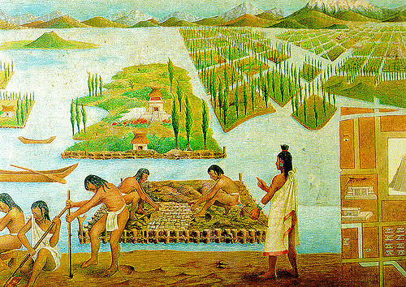
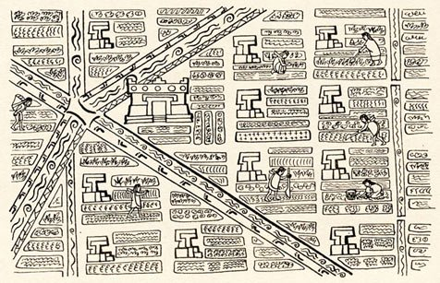
Chinampas, The Floating Gardens of Mexico
An artist’s impression of part of the canal network linking chinampas around Tenochtitlan
Chinampa agricultural system, the so-called ‘floating gardens’ which can be found on the shallow lake beds in the Valley of Mexico. The Aztecs used these stunning floating gardens to grow their crops without harming the environment. Chinampas were created by piling mud and decaying plants into small stationary islands on top of which the farmers would sow maize, beans, chilies, squash, tomatoes, and greens.

Slide 20
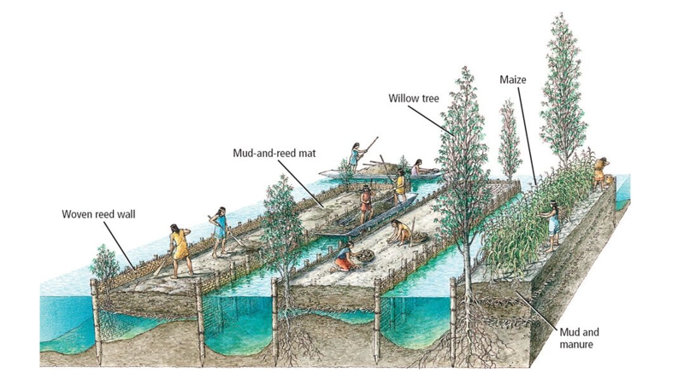

Slide 21
Helpful video links :
https://youtu.be/Q6eBJjdca14
https://youtu.be/cnMa-Sm9H4k
https://youtu.be/HrfKOQKyffE
https://youtu.be/fmHVqb6t__8

